Slide 1
Tissue Paper, the Smart Choice: Hygienic and Sustainable
Academy of Fine Arts BOLOGNA
January 19th
2023 Roberto Berardi
Competition to create a cartoon or an illustration to be used in institutional campaigns, in collaboration with the Academy of Fine Arts in Bologna
www.europeantissue.com

Slide 2
Content of this presentation
This is an introductory presentation to the ETS (European Tissue Symposium), its main activities and to the Worldwide Cartoon Contest being launched in these days.
In order to provide some background to the participants to the contest, this document illustrates:
the AFH (Away From Home) Tissue Products and how they help to achieve a superior level of Hygiene.
the results of the Hygiene studies supported by ETS and conducted by the Westminster University, by Eurofins-Inlab, the conclusions of the scientific article on Mayo Clinic Proceedings and Consensus Statement of a Panel of six eminent Microbiologists.
the indications provided by the leading Worldwide Health Authorities (which are perfectly consistent with the outcome of our studies)
But doesn't using paper products pose ecological problems? Let's debunk some myths about paper by getting to know it better.
The basics of paper product sustainability. What are the PRIMARY CONTENTS of this Contest?
Some examples from previous competitions, the «rules of the game».
2

Slide 3
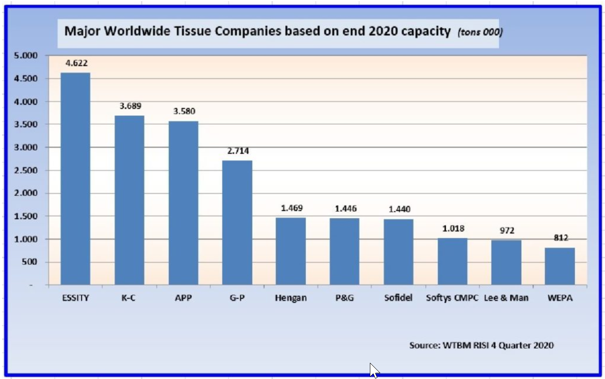
The world's leading manufacturers of tissue products
* MEMBERS of ETS
*
*
*
*
3
3

Slide 4
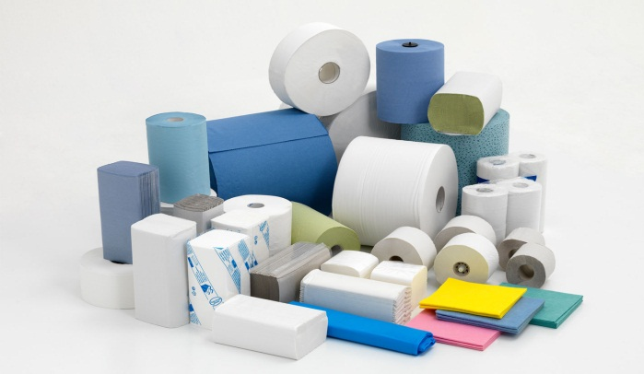
L’ ETS (European Tissue Symposium) is the Association of the European Tissue Producers
Members dell’ European Tissue Symposium
* ESSITY (previously SCA) (S/D)
* Sofidel (I)
* WEPA (D)
Metsä Tissue (S/FIN)
* Kimberly-Clark Europe (GB)
Lucart (I)
Cartiere Carrara (I)
Industrie Celtex (I)
Renova (P)
MP Hygiene (F)
*
4
4

Slide 5
ETS activities
The European Tissue Symposium (ETS) (www.europeantissue.com) represents 90 per cent of tissue production in Europe.
Its purpose is:
to monitor events and developments within the European Tissue industry, and ensure members are kept informed
to research and develop issues that have an impact on tissue
to liaise with NGOs and European institutions
to improve the science behind tissue usage, by producing bespoke advanced Studies using the most authoritative institutions, including Users preference studies, LCA / Carbon Footprint studies, Hygiene studies, Food contact, Sustainability, etc.
to define and communicate Industry Position Papers on relevant issues
to promote tissue usage
to increasingly use Internet to communicate with all the relevant Stakeholders (about 2.4 million visits/video views in the last year)
5
5

Slide 6
Comparison Tissue Consumption - Life expectancy
JAPAN
ITALY
SWEDEN
CANADA
FRANCE
GERMANY
KOREA
UK
TAIWAN
USA
POLAND
CHINA
BRASIL
RUSSIA
INDIA
Data: per capita Tissue cons: EU Consulting Life Expectancy at birth: Gapminder
6
6
6

Slide 7
Hygiene of hands, surfaces and air: main studies
Microbes on Hands + other aspects
Study UoW 2008
Study TUV LGA 2011
Microbes on surfaces
Study Eurofins/Inlab 2012
Hygiene
Study Leeds Dispers. 2014
Microbes in the air
Study UoW Dispers. 2015
Study UoW Virus 2016
Microbies on surfaces and in the air
Laboratory Studies
Study Multisite 2018
Real Life Studies
Viral load on aasks
Study Leeds 2022
Extensive insights into all the studies on the pages of the EUROPEANTISSUE.com website

Slide 8
Main results of some important laboratory studies
These accurate laboratory studies have proven that:
The potential for contamination of the washroom environment, air and nearby people is much greater when jet air dryers are used.
Contamination of the bathroom environment (aerosolization) after hand drying:
Jet air dryers: 71 CFU,
Hot air dryers: 16 CFU,
Paper towels: 3 CFU https://europeantissue.com/hygiene/studies/potentialcontaminationenvironment2014/
E.B., P.P., M.W., Leeds 2014
Virus particles detected (at predefined heights and different distances, average of detections)
Air jet dryers: 3,005 virus particles,
Hot air dryers: 104 virus particles,
Paper towels: 15 virus particles https://europeantissue.com/hygiene/studies/hand-dryingsingleuse-towels/
P.K., K.R., Westminster 2015
Contamination of the body of the person drying their hands was also higher with jet air dryers vs. hot air vs. paper towels. (droplets in upper body: 144 : 66 : 0)

Slide 9
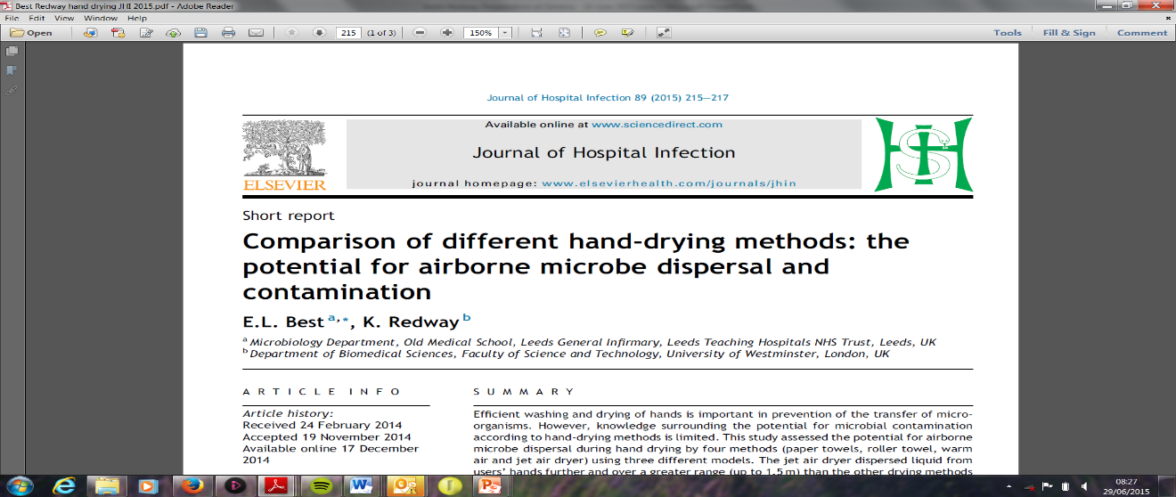
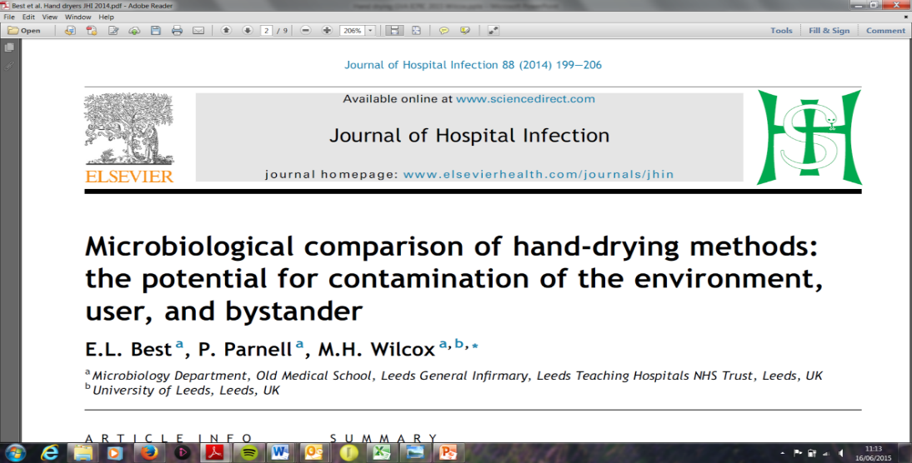
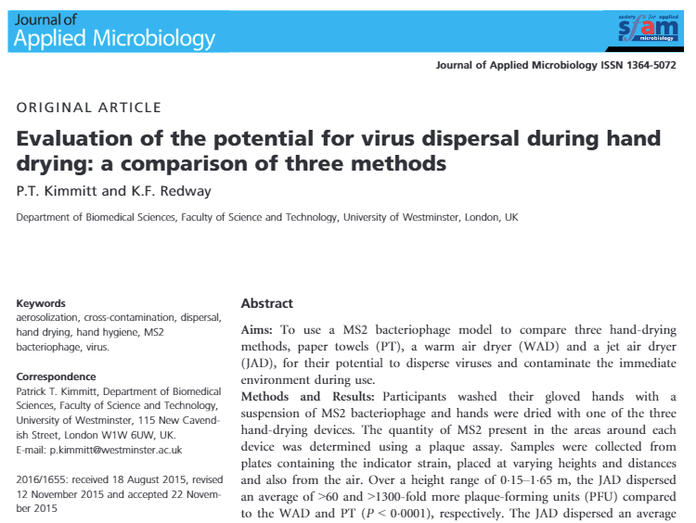
The results of previous laboratory studies have been peer reviewed and are published in leading scientific journals dealing with infections
These fundamental laboratory studies, carried out in particular at the Universities of Leeds and Westminster, can be consulted on the pages of the site: «europeantissue.com»:
https://europeantissue.com/hygiene/studies/comparison-of -different-hand-drying-methods/
https://europeantissue.com/hygiene/studies/potentialcontaminationenvironment2014/
https://europeantissue.com/hygiene/studies/hand-dryingsingleuse-towels/

Slide 10
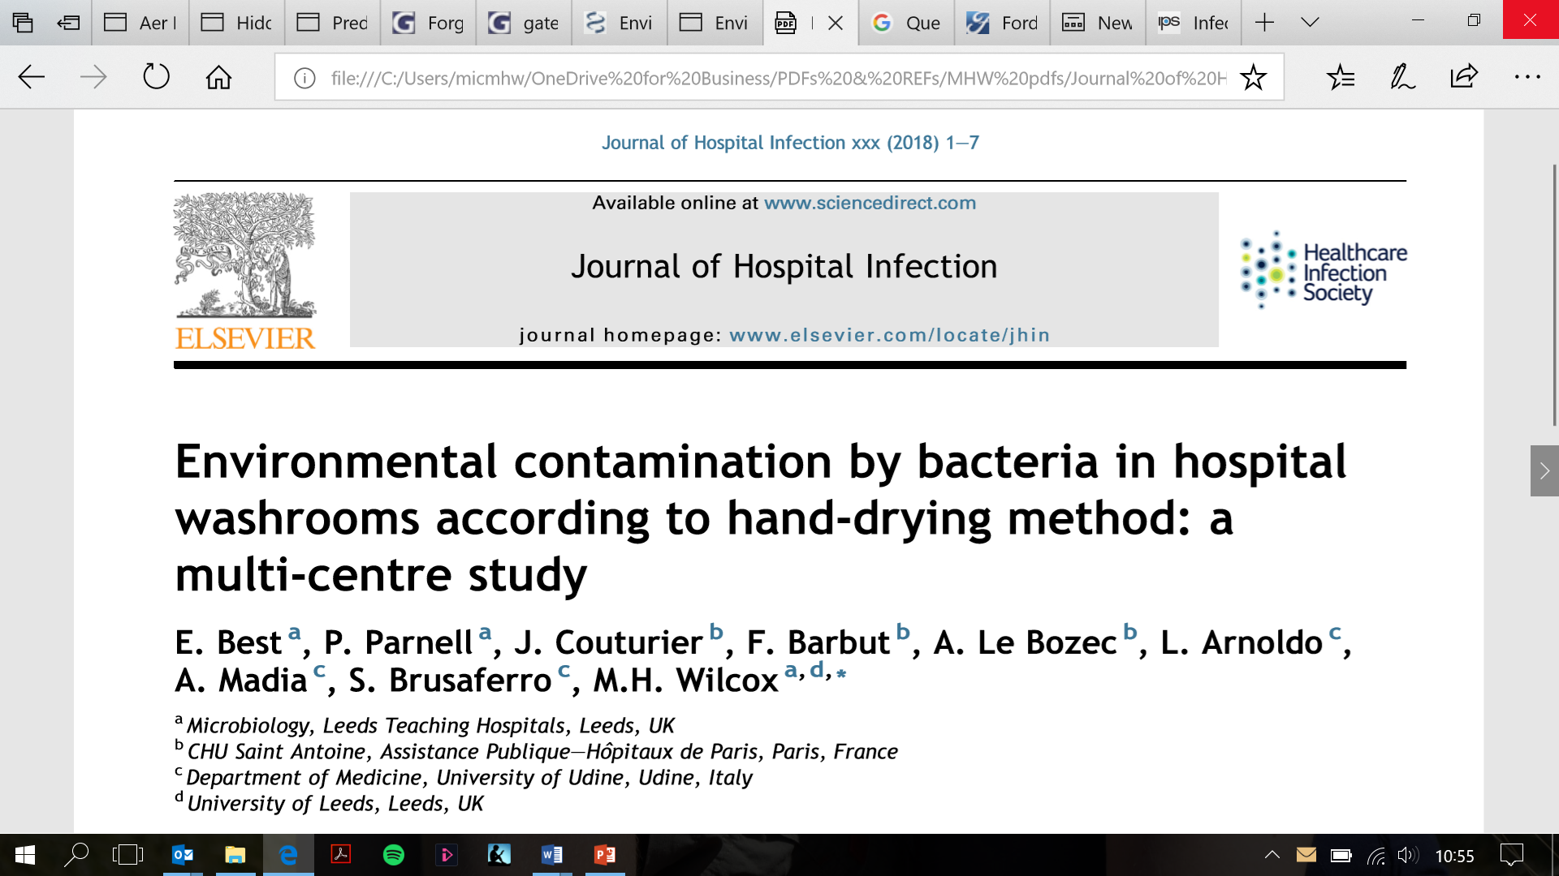
The fundamental multisite real life study carried out in England, France and Italy has been published in the important scientific journal: Journal of Hospital Infection
https://europeantissue.com/hygiene/studies/multisite-hospital-study/

Slide 11
Multisite Hospital Study Video: is your hand drying system spreading bacteria?
https://www.youtube.com/watch?v=7knscx3ZROA
11
11
11
11
11
11
11
11
11

Slide 12
Video: The truth about Tissue Paper - Hygiene
https://www.youtube.com/watch?v=KSOPAjObg0A&t=10s
12
12
12
12
12
12
12
12
12

Slide 13
Also the most Authoritative Health Institutions in the World do recommend the use of Paper Hands Towels
In the ETS Website we publish the instructions for hands washing and drying provided by the leading Health related Institutions around the world. Among them:
World Health Organization (WHO)
CDC (Centers for Disease Control and Prevention)
UK Health Protection Agency (HPA)
UK National Health Service (NHS)
World Union of Wholesale Markets (WUWM) for FOOD Business
European Committee for Standardisation (CEN) in their document "Guidelines on HACCP, GMP and GHP for ASEAN Food SMEs"
Additionally, in the page “hygiene in the world”, we also publish the link to a number of national institutions /health authorities websites, dealing with hygiene, from The Koch Institute, to the French Ministry of Education, to the UK Department of health, etc. etc.
www.europeantissue.com

Slide 14
The World Health Organization (WHO) strongly recommends the use of single use Towels in their Hand Washing Poster
A key point in these recommendations is:
"DRY HANDS THOROUGHLY WITH A SINGLE USE TOWEL; use towel to turn off faucet."
14
14
14
14
14
14
14
14
14

Slide 15
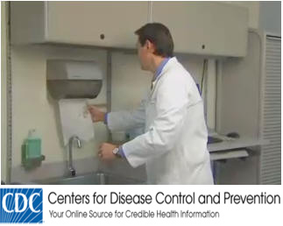
The CDC (Centers for Disease Control and Prevention), a USA. Gov. initiative, strongly recommends the use of Paper Towels
The CDC (Centers for Disease Control and Prevention), a USA. Gov. initiative, publishes in the page "Health Hygiene in Healthcare Settings" a complete set of instructions to obtain the best Hands Hygiene.
The WHO Poster "How to Handwash" is quoted.
Single use Towels are recommended.
An interesting video is also presented, illustrating the importance of careful Hands washing and Drying, to reduce transmission of pathogenic microorganisms.
On the ETS Website: www.Europeantissue.com the complete CDC’s hands washing instructions VIDEO is published
15
15
15
15
15
15
15
15
15
15

Slide 16
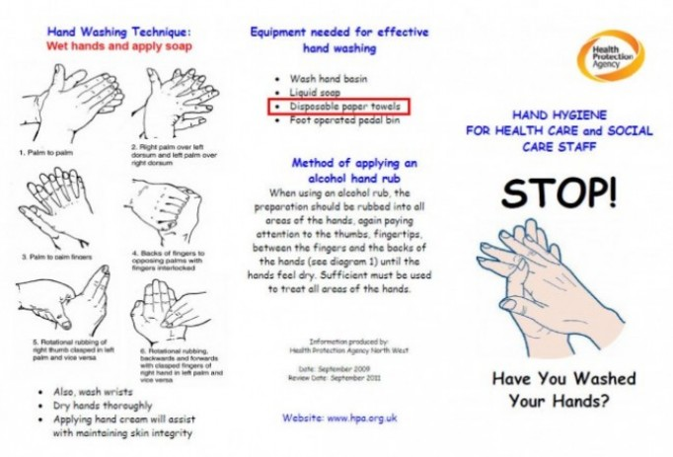
The HPA (UK health Protection Agency) and the NHS (National Heath Service) indicate for the best hygiene the use of Paper Towels
The UK Health Protection Agency (HPA) www.hpa.org.uk/provides advice on Hand Washing for the general public.
The equipment needed for effective hand washing includes: "DISPOSABLE PAPER TOWEL"
The complete HPA document can be found at the ETS Website.
NHS provides a complete "MRSA Guidance for nursing staff", also available at the ETS website,. Among the fundamental indications, see in page 7:
"DRY WELL USING DISPOSABLE PAPER TOWELS".
These instructions are provided by HPA the UK Health Protection Agency.
16
16
16
16
16
16
16
16
16
16

Slide 17
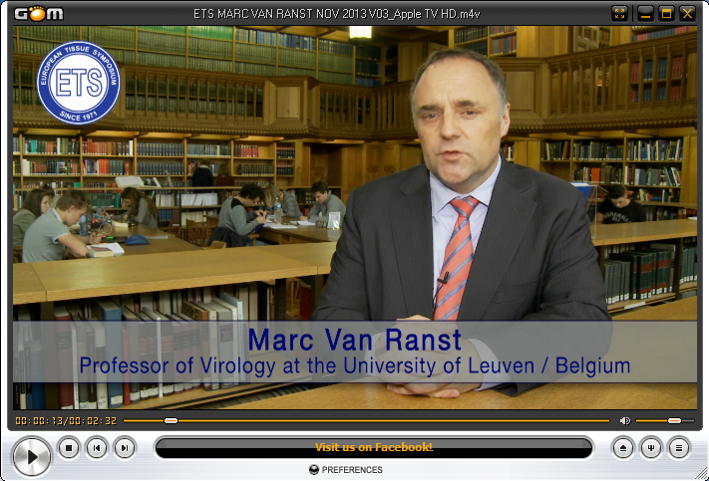
HAND DRYING – AN IMPORTANT PART OF HAND HYGIENE – Consensus reached by a Panel of Eminent European Scientists
Leading European microbiologists and hospital
hygienists have produced a Consensus Statement stating that hand drying using towels is associated with lower numbers of microbes on the hands and in the washroom environment than using warm air dryers or high velocity air dryers.
Consensus Statement
Hand drying: an important part of hand hygiene Conclusions reached by a panel of European scientists
The importance of good hand washing to prevent the spread of infection is widely accepted by scientists and the public. However, hand drying receives much less attention.
Some potentially harmful microbes remain on the hands after washing, and these are more easily spread if hands are not dried adequately.
Proper hand drying completes the hand washing process by reducing the risk of spread of microbes.
Generally available hand drying methods in public washrooms are based on either water absorption (single use towels – paper or textile), water evaporation or water dispersal (warm air or jet air dryers).
Warm air dryers are usually slower than other methods at drying the hands.
There is scientific evidence that hand drying with single use towels rather than warm air or jet air dryers leads to lower numbers of microbes on hands and in the washroom (both in the air and on surfaces).
Jet air dryers are particularly likely to blow bacteria and viruses off the hands and around the washroom. Potentially harmful microbes could contaminate the user, other persons, the air we breathe and surfaces we touch, both in and outside the washroom.
Microbes from poorly washed hands may persist in the air for at least 15 minutes after the use of these jet air dryers.
The public and decision makers should be aware that some hand drying methods increase the risk of contaminating the hands, other individuals, the washroom surfaces, the air and areas outside the washroom.
These findings have implications for the prevention of spread of microbes and infections and could result in reduced illness and time off sick and so ultimately provide economic benefit too,” said Marc Van Ranst, professor in virology and chairman of the Department of Microbiology and Immunology at the University of Leuven in Belgium
Experts Meeting, Leuven, Belgium, 11 Ottobre, 2022, Professor Marc Van Ranst, 2013 – presente oggi Professor Mark Wilcox, 2013 – presente oggi Professor Frédéric Barbut, 2015 – presente oggi Professor Angel Asensio, 2015 – presente oggi Professor Silvio Brusaferro, 2013 – fine 2018 Emeritus Fellow Keith Redway, 2013 – presente oggi Professor Bertil Kaijser 2013 – 2015 Dr Ralf Kammerer 2013 – 2015 Prof. Dr. Prof. Walter Popp, 2020 – present

Slide 18
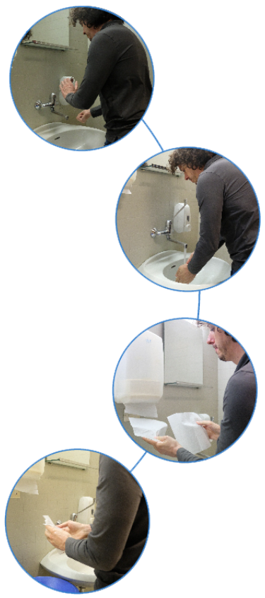
Even the example counts...
Hand washing
URSULA VON DER LEYEN explains how to wash your hands thoroughly and how to use a PAPER TOWEL to dry them and to turn off the tap.
A similar video was posted
by Tedros Adhanom Ghebreyesus, Director General of the World Health Organization

Slide 19
Why are disposable towels the most hygienic way to dry your hands?
SCIENCE supports the use of disposable towels Scientific studies show that disposable towels provide superior hygiene. Expert microbiologists have measured the impact of different hand drying methods on the spread of pathogens and washroom hygiene..
THE HOSPITALS recommend the use of disposable towels For hospitals, where hygiene is crucial, experts recommend using disposable towels:
German hospitals recommend the use of disposable towels in bathrooms due to their excellent hygienic properties.
The French Hospital Hygiene Society, SF2H1, advises against the use of electrical devices in hospitals and advises the use of paper towels to minimize infections.
GOVERNMENTS AND AUTHORITIES INVOLVED IN HYGIENE
They recommend disposable towels
Public hygiene standards require disposable towels to be placed in bathrooms adjacent to kitchens. Jet air dryers tend to contaminate the air and surfaces.

Slide 20
And what about Sustainability?
Well, we have seen the benefits of Tissue products and found that they are supported by the world's top Health Authorities …
but… are paper products really sustainable? There is a lot of unfavorable opinion about paper… shouldn't trees be cut down to make paper products?
Let's start with a Danish animation to make a first
acquaintance with wood
www.europeantissue.com
Notes:
https://www.youtube.com/watch?v=FcRc3F13hXc
https://www.youtube.com/watch?v=enCcMWBmmjc

Slide 21
E la sostenibilità?
https://www.youtube.com/watch?v=t6XEUAhm5SQ
21
21
21
21
Notes:
https://www.youtube.com/watch?v=FcRc3F13hXc
https://www.youtube.com/watch?v=enCcMWBmmjc

Slide 22
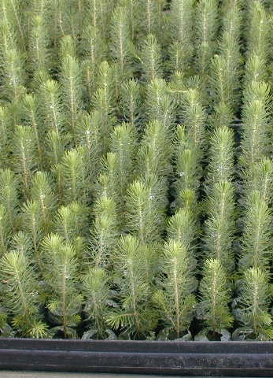
Let’s examine some of the myths about Paper: 1) The paper industry destroys forests
The reality
The myth
The paper industry contributes to keep up forests.
The paper industry practices sustainable forest management.
The paper industry is not responsible for the depletion of tropical forests.
The paper industry destroys forests
Comments:
Around 11% of the timber felled throughout the world is used to make paper (FAO 2007)
The Food and Agriculture Organization (FAO) reckons that there is an annual forest growth of 0,5 per cent in the Northern Hemisphere, equivalent in Europe alone to the area of 1.4 million football pitches.
Deforestation is generally occurring in the southern hemisphere and is mainly due to conversion of forests into agricultural land and for fuel wood collection*
*(FAO Global Forest Resource Assessment)
22
22
22
22

Slide 23
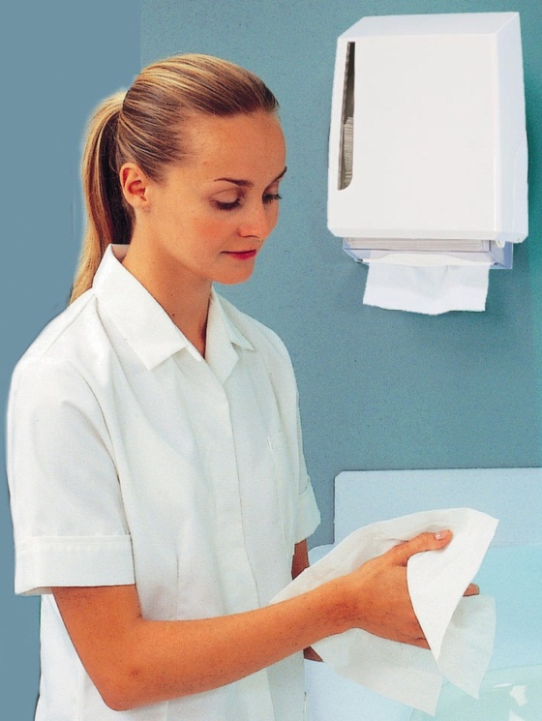
Let’s examine some of the myths about Paper: 2) The utilization of Paper products should be minimized
The myth
The reality
The utilization of Paper products should be minimized
Paper supports sustainable consumption.
Paper is made from renewable raw materials.
Recycling spares resources.
Comments:
We need paper for our daily hygiene. Unlike other materials, paper is made from a renewable material: wood. Sustainable forest management will ensure that forests grow and enough material is available.
The paper industry’s motto is doing more with less: making paper with fewer materials, less energy increasingly renewable, in more efficient machines, towards zero waste, and providing needed products.
As much as 74% of paper in use is collected for recycling. More concretely, nine out of ten corrugated boxes are made from recycled fibre; and nine out of ten newspapers are made with recovered paper.
23
23
23
23
23

Slide 24
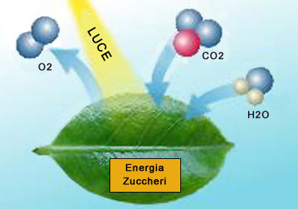
Let’s examine some of the myths about Paper: 3) Paper production is bad for the environment
The reality
The myth
Paper is one of the few sustainable products.
The paper industry has reduced its environmental impact greatly over the last 10 years.
Paper products store CO2.
Paper production is bad for the environment
Comments:
Paper boasts exceptional environmental credentials: it’s natural, biodegradable, recyclable, comes from an infinitely renewable resource and is produced in a sustainable manner.
Through nature’s own process – the photosynthesis – trees capture and store billions of tonnes of carbon, day after day. The carbon sequestered in forests is subsequently stored in products made of wood, such as paper, and the carbon storage is further prolonged by recycling paper.
While paper production has increased steadily in the last 10 years, environmental impacts have decreased.
LIGHT
SUGARS → WOOD
24
24
24
24
24
24

Slide 25
Let’s examine some of the myths about Paper: 3) Paper production is bad for the environment
The myth
The reality
All paper should be recycled
Europe is the world leader in paper recycling.
To keep the recycling process going, fresh fibers are needed.
Comments:
Paper is the most recycled material in Europe and more than half of the paper produced comes from recycling. In Europe, 74% of paper is collected for recycling (87%in Italy!) Recycling rate has increased 30% in the last 20 years
Year after year paper recycling rates continue to rise and when fibres can no longer be used they can be converted into renewable or green energy. It is estimated that it can be reused four to eight times on average.
Some paper grades, due to their end use, need to offer characteristics that can best be provided by virgin fibre.
25
25
25
25
25
25
25

Slide 26
Let’s examine some of the myths about Paper: 5) Paper production uses too much energy
The myth
The reality
Paper production uses too much energy
The paper industry has considerably reduced its energy requirement.
58% of the energy used by the European paper industry is bio-energy.
Comments:
Energy is required for all industrial production. Of course also the paper industry requires energy to operate its machines and to dry the paper web.
About half of the energy used in the European paper industry already comes today from renewable energy sources.
Around 500 kWh of energy are required to make 200 kg of paper, which is about the annual per capita consumption in Europe. Tissue is about 15Kg. Energy used for Tissue in a year is equivalent to the energy consumed by a typical household leaving its electronic equipment on stand-by in a month!
26
26
26
26
26
26
26
26

Slide 27
Let’s examine some of the myths about Paper: 6) Paper production is bad for the climate
The myth
The reality
The European Council has recognized wood products as climate friendly.
The paper industry has reduced its carbon dioxide emissions.
Sustainable forest management helps reduce worldwide carbon dioxide emissions
Paper production is bad for the climate
Comments:
The main source of raw material for paper - trees – is a vast carbon store and the prime absorber of CO2 from the atmosphere. Young trees are much more efficient at absorbing carbon than old forests.
Mature trees absorb carbon slower the older they get. To maximize the carbon storage we need young healthy forests where trees are regularly harvested and re-grown.
Paper also continues to store carbon throughout its lifetime. Still, around 160 kg of CO2 are emitted during the production of 200kg of paper, equivalent to the amount emitted by a typical car over 1,000 km. 15 Kg of Tissue yearly are equivalent to 75 Km.
1 Year of Tissue (≈ 15 KG) 75 Km by car
27
27
27
27
27
27
27
27

Slide 28
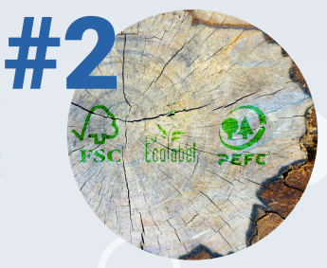
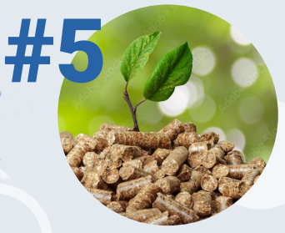
In summary SOME FACTS about the sustainability of paper products
Tissue Paper is a sustainable industry based on raw material with a growth cycle of 20 - 50 years in sustainable forests
Sustainability goes beyond raw materials, the Tissue sector is committed to reducing water and energy consumption, developing a circular business model.
Already today 58% of the energy used by the paper sector derives from renewable biomass and the water required for 1 ton of pulp 5 times less than in 1970
Over 80% of the pulp used by the European paper industry is certified by the main FSC and PEFC systems
Trees play a vital role in reducing CO2 by capturing and storing Billions of tons of CO2, mostly as they grow up
Packaging is also becoming increasingly recyclable and makes increasing use of recycled raw materials
28
28
28

Slide 29
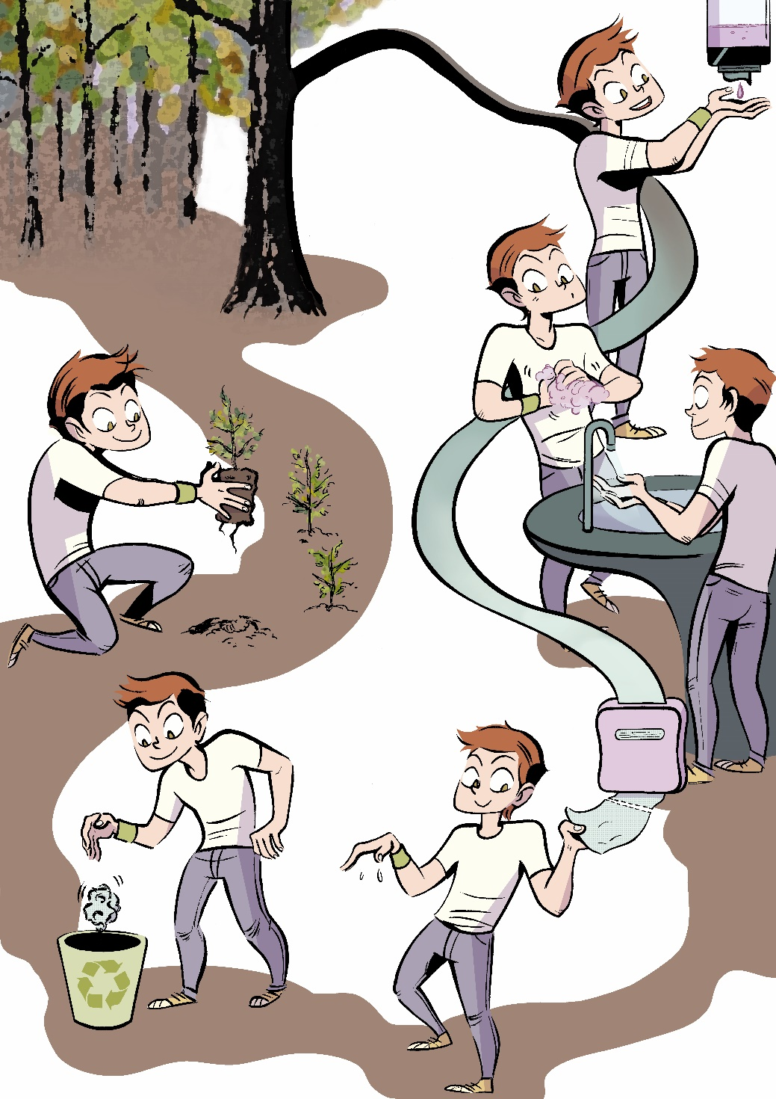
Cartoon Contest 2012, Academy Winner
Stefania Potito: Tree, Paper and Life
Hands Hygiene and Sustainability are both present in this illustration
29
29
29

Slide 30
Introduction to the sustainability of tissue paper products «THE TRUTH ABOUT TISSUE PAPER»
https://www.youtube.com/watch?v=F_xLpBQu19w
30
30
30

Slide 31
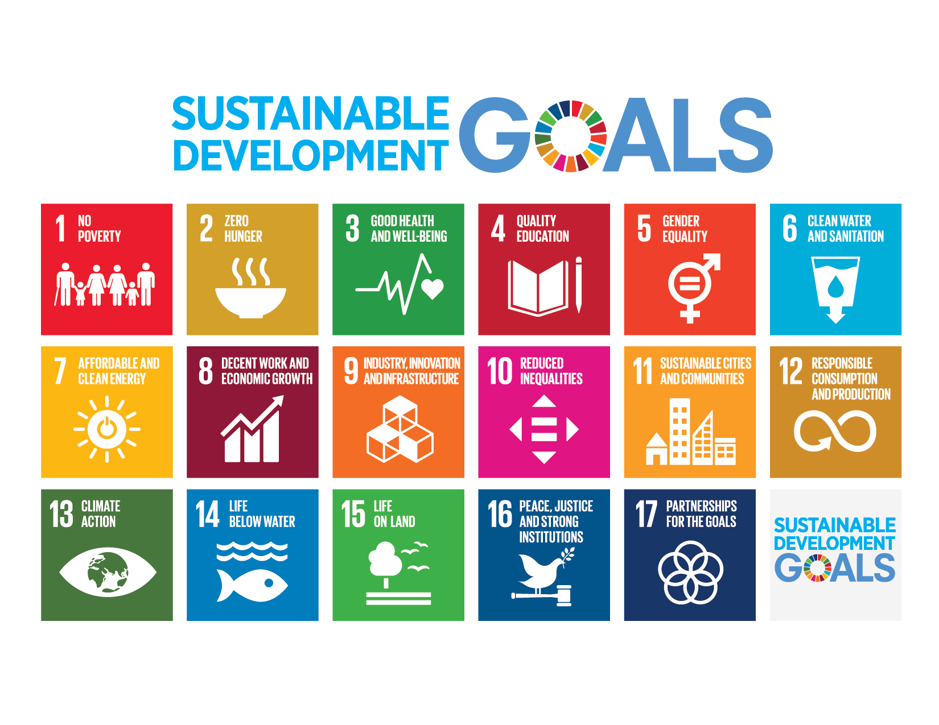
Sustainable Development Goals
The Sustainable Development Goals (SDGs) or Global Goals are a collection of 17 interlinked objectives designed by the United Nations to serve as a "shared blueprint for peace and prosperity for people and the planet now and into the future“. They are also known as Agenda 2030, from the name of the document entitled Transforming our world. The 2030 Agenda for Sustainable Development recognizes the close link between human well-being, the health of natural systems and the presence of common challenges for all countries.
All 193 United Nations member states have ratified the 2030 Agenda.
In particular, for the world of paper TISSUE PRODUCTS, the sustainable development objectives set out here on the side are identified as relevant
31
31

Slide 32
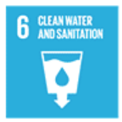
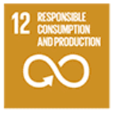
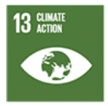
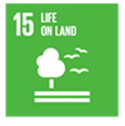
Sustainable Development Goals relevant to Tissue
3: Good health and well-being Ensure healthy lives and promote well-being for all at all ages
6: Clean water and sanitation Ensure availability and sustainable management of water and sanitation for all
8: Decent work and economic growth Promote sustained, inclusive and sustainable economic growth, full and productive employment and decent work for all
12: Responsible consumption and production Ensure sustainable consumption and production patterns
13: Climate action Take urgent action to combat climate change and its impacts by regulating emissions and promoting developments in renewable energy
15: Life on land Protect, restore and promote sustainable use of terrestrial ecosystems, sustainably manage forests, combat desertification, and halt and reverse land degradation and halt biodiversity loss
32
32
Notes:
https://it.wikipedia.org/wiki/Obiettivi_di_sviluppo_sostenibile#Obiettivo_1:_Povert%C3%A0_Zero

Slide 33
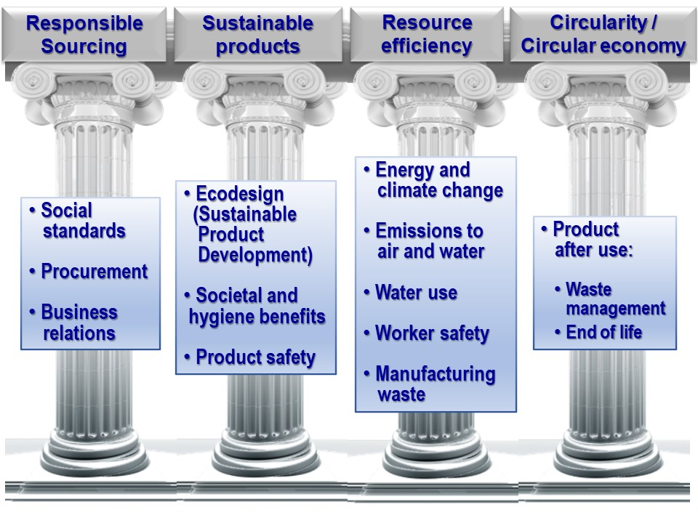

Slide 34
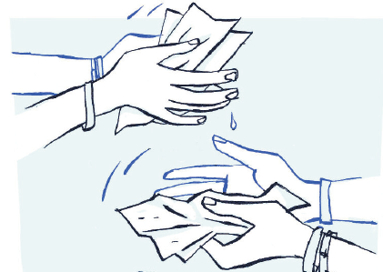
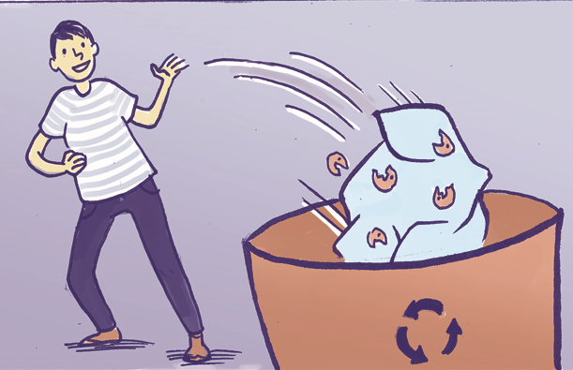
The four essential chapters of sustainability: these texts are the main guide for your Cartoons
They MUST carry out their task in a hygienic and safe way for the consumer.
MUST BE SOURCED RESPONSIBLY, be made from renewable materials obtained from certified sustainable sources (such as sustainable forests or recycled paper).
THEY ARE PRODUCED WITH OPTIMIZED USE OF RESOURCES energy, water, minimum waste and maximum safety for workers.
THEY ARE PART OF THE CIRCULAR ECONOMY as their waste can be transformed into a new resource.
34
34
Notes:
https://it.wikipedia.org/wiki/Obiettivi_di_sviluppo_sostenibile#Obiettivo_1:_Povert%C3%A0_Zero

Slide 35
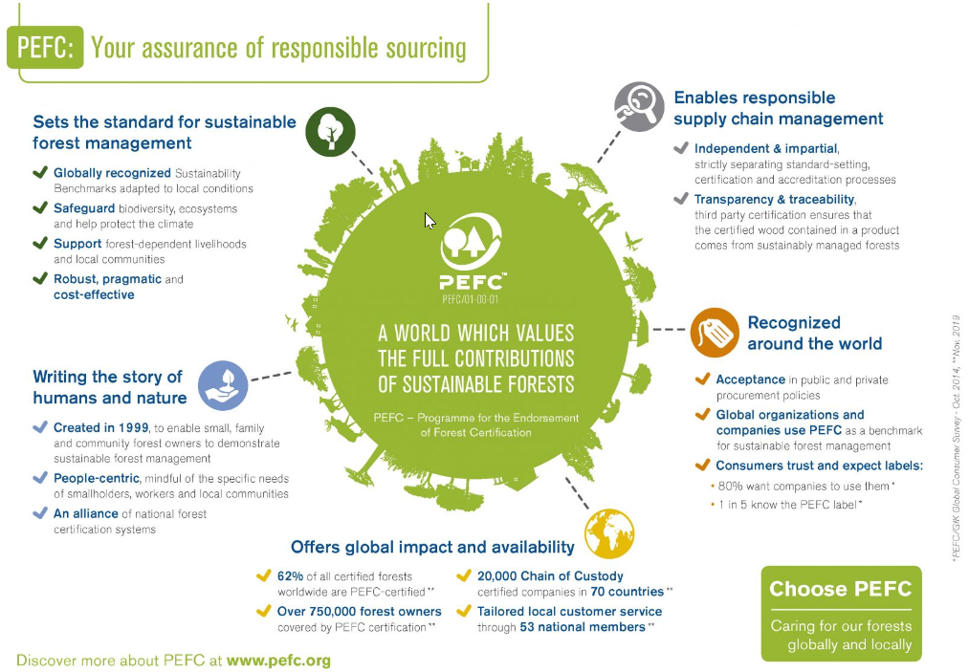
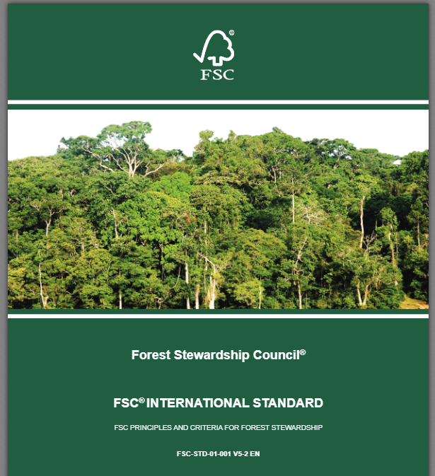
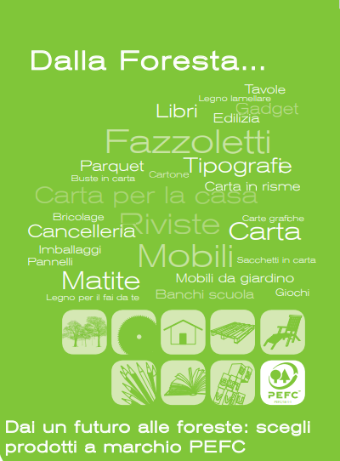
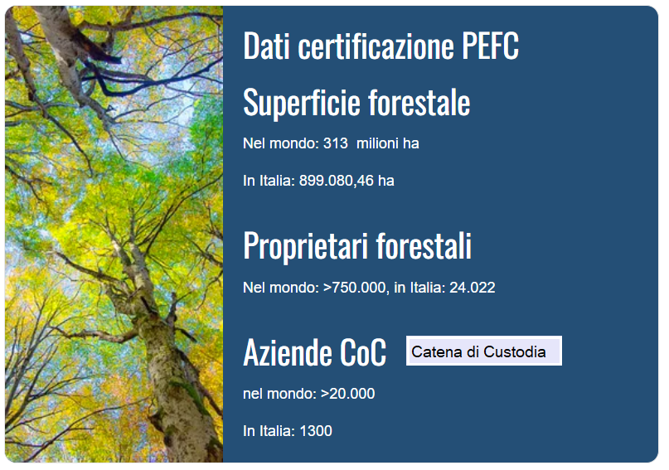
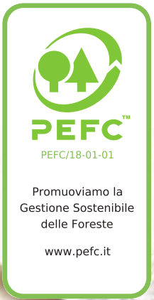
MUST BE SOURCED RESPONSIBLY, be made from renewable materials obtained from certified sustainable sources (such as sustainable forests or recycled paper).
What is sustainable forest management?
"The management and use of forests in a way and at a rate that maintains their biodiversity, productivity, regenerative capacity, vitality and their potential to perform, now and in the future, specific ecological, economic and social functions, locally, nationally and globally, causing no harm to other ecosystems." This is how the concept of Sustainable Forest Management was defined by Forest Europe.
What is certification?
Forest certification is a tool created to promote sustainable forest management and ensure that forest-based products that reach the market come from sustainably managed forests.

Slide 36
They MUST carry out their task in a hygienic and safe way for the consumer.
Paper guarantees the highest level of hygiene
[See also the entire first part of this presentation.]
It protects people and helps keep them safe and healthy. Whether you're at home or out and about, you can trust the card to keep you safe. Paper products play an important role in promoting hygiene, minimizing the spread of infections and keeping us healthy.
Paper handkerchiefs are part of our daily life. Whether it's scooping up sneezes or mopping up spills, you never know when you'll need a tissue on hand. And because they're disposable, you can be sure you won't pass on infections.
It is scientifically proven that using paper towels and kitchen paper towels with absorbent properties are an extremely hygienic way to dry your hands after washing and also to clean surfaces. Whether it's at home or away, your family, customers and staff deserve
the best. Paper towels are an ideal solution in both domestic and commercial settings.
Toilet paper is a staple in any bathroom - at home, in restaurants, in public places. Toilet paper is a universal reference product that we all know and trust because it is hygienic and helps reduce the risk of infections.

Slide 37
THEY ARE PRODUCED WITH OPTIMIZED USE OF RESOURCES energy, water, minimum waste and maximum safety for workers.
How do Tissue Products companies in Europe optimize their resources?
ENERGY: ETS member companies are committed to mitigating climate change by meeting the global consumer goods industry's goal of reducing carbon emissions through innovation in individual manufacturing processes, supply chains and products, in order to advance the Paris Agreement goal of limiting global temperature rise to well below 2.0°C by the end of the century and pursue a path to keep it to 1.5°C.
USE OF WATER: The Tissue Paper sector provides hygienic solutions for the health and well-being of consumers and the community. The tissue industry uses a significant amount of water in papermaking because the water carries and distributes the fibers across the paper machine wire to form the paper. However, more and more the water used remains mainly in the process and is cleaned after use.
SAFETY FOR WORKERS: All ETS member companies are committed to ensuring that workplace safety is the number one priority for all employees: all occupational injuries and illnesses must be prevented through research and engineering activities , product development, production, delivery and sales. The workplace must meet or exceed applicable occupational safety and health laws and regulations. You must establish occupational safety and hygiene standards based on best practice, striving to continuously improve your occupational safety and hygiene performance. All personnel must contribute to the improvement of safety.

Slide 38
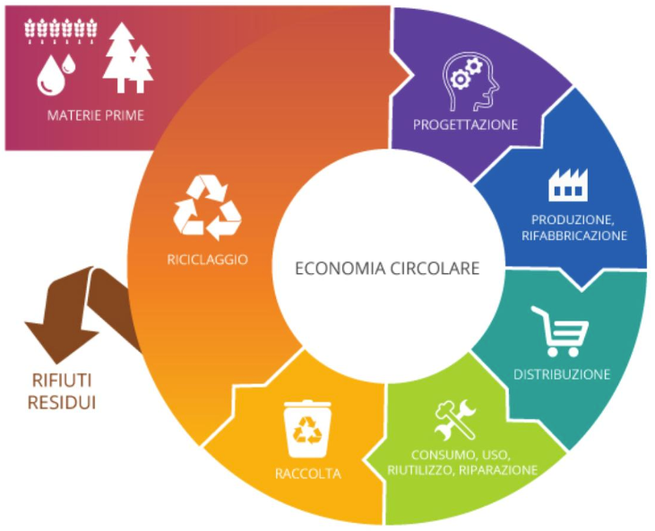
FANNO PARTE DELL'ECONOMIA CIRCOLARE in quanto i loro rifiuti possono essere trasformati in una nuova risorsa.
The European Green Deal aims to transform the EU into a modern, resource-efficient and competitive economy, moving towards a zero-pollution ambition to protect the EU’s natural capital and citizens’ health and well-being.
Tissue products are usually single use products and typically go to waste after use. Recycling options may still be limited compared to packaging material, but tissue products fit nicely into existing waste management schemes and could even provide a benefit there (incineration with energy recovery(1) or composting).
Individual ETS member companies are committed to support the development of new circular business models with the aim to increase the amount and degree of product recovery and to minimize waste. This includes the recovery of material through recycling of packaging and used tissue where possible and appropriate (e.g. used hand towels), or the beneficial use via composting, incineration with energy recovery, and avoiding landfilling.

Slide 39
The role of a comic or illustration work
Even being known to experts, the results of scientific studies
are still ignored by the general public. Furthermore, there are several false myths about paper, which instead is among the most sustainable industrial products there are.
Young people in particular are almost totally unaware of the greater hygiene benefits of drying their hands with paper.
The objective of the cartoon or illustration work and of the videos was in previous editions of the competition to briefly illustrate the superior guarantees of hygiene guaranteed by paper products, compared to electric dryers, while this edition wishes to focus on the various aspects of the sustainability of paper products.
The availability of a modern and easy-going message opens up the possibility of using synthetic media, such as Posters, Social Media, a large presence on the ETS Website, use in press editorials, obviously always within the context of information signed and controlled by the ETS.
39
39
39
39

Slide 40
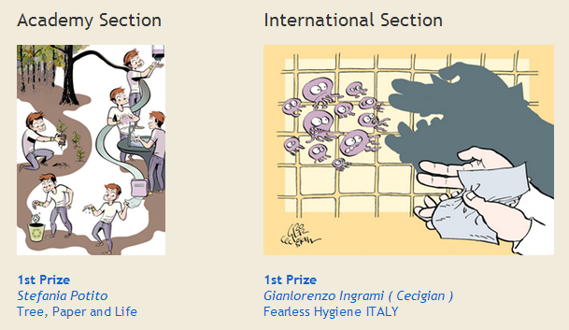
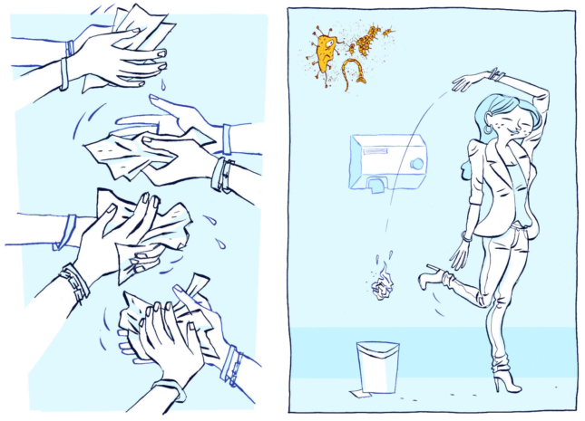
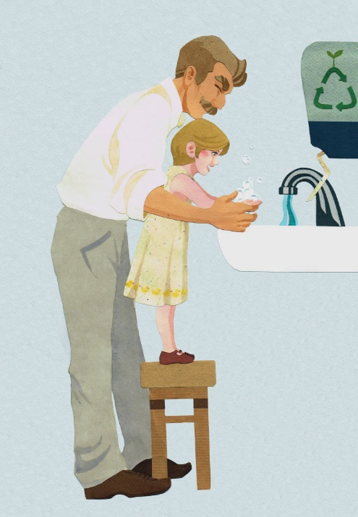
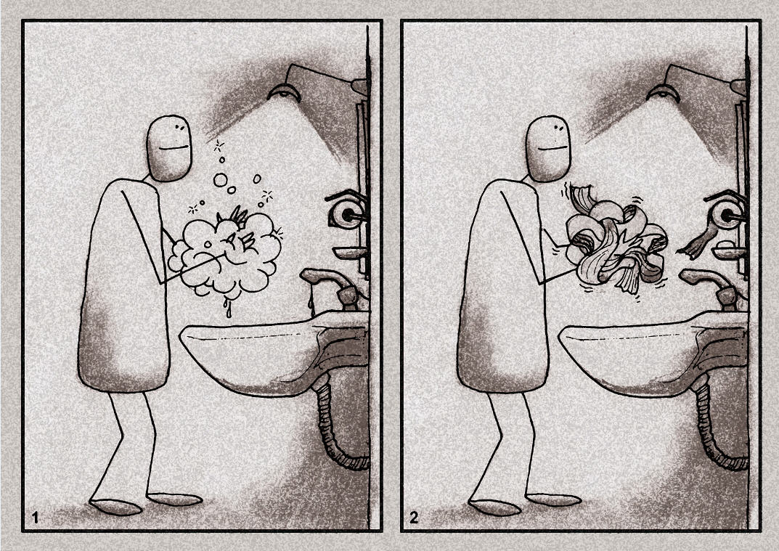
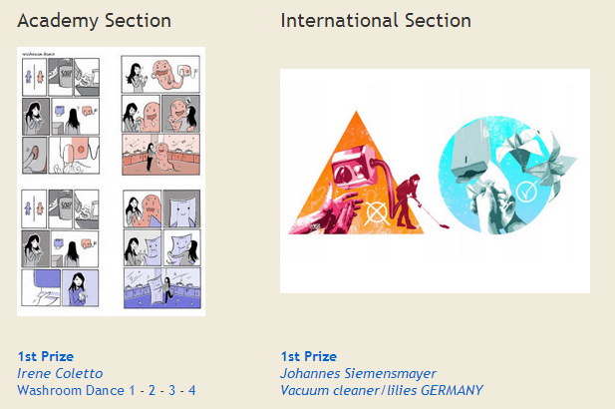
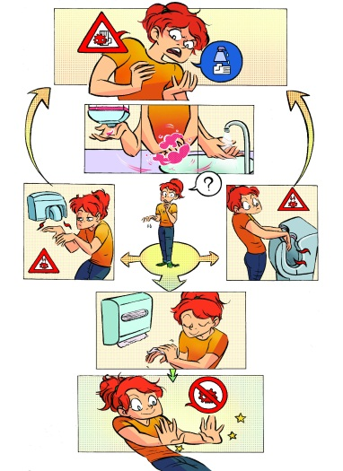
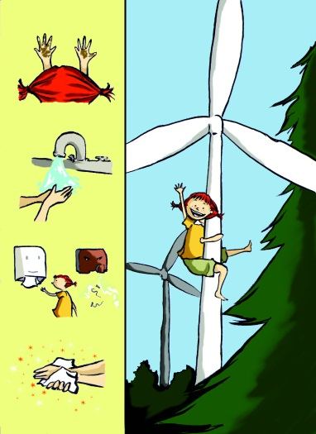
Winners of the Cartoon Contests
2011 - 2012 – 2013 - 2014
2011
2012
E
2014
2013
Rahim Biyarash (IRAN)
Soap-paper
Elisa Canaglia
Our future

Slide 41
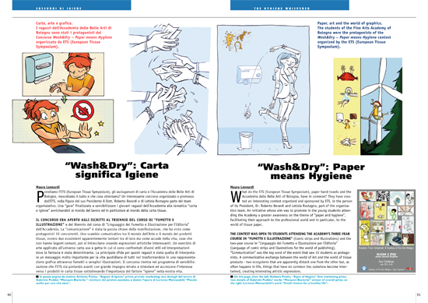
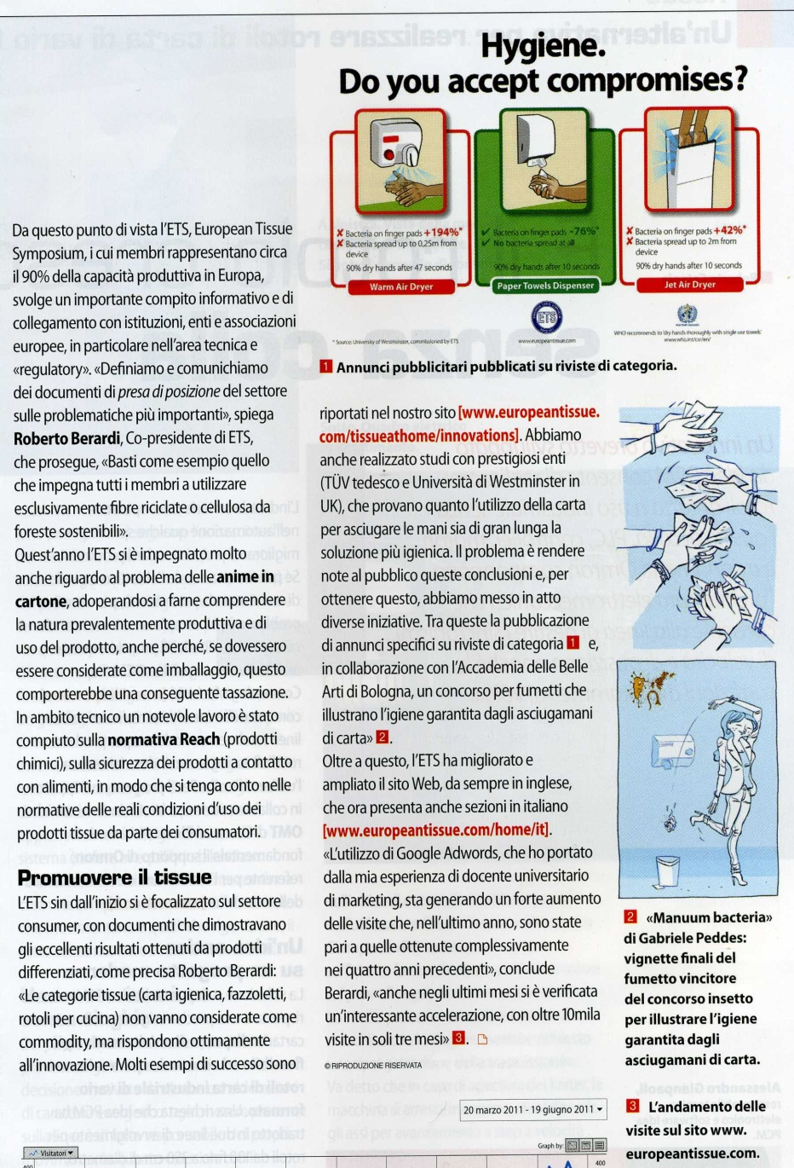
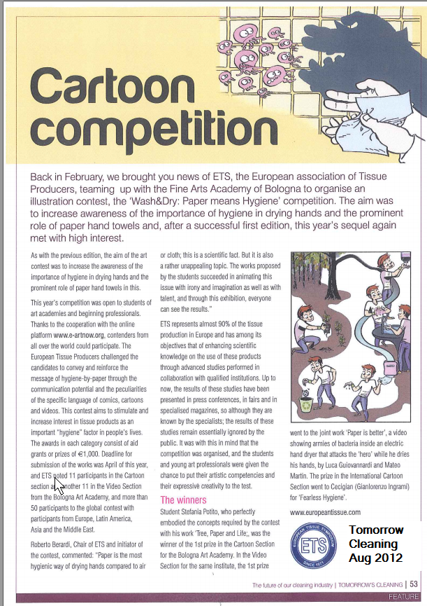
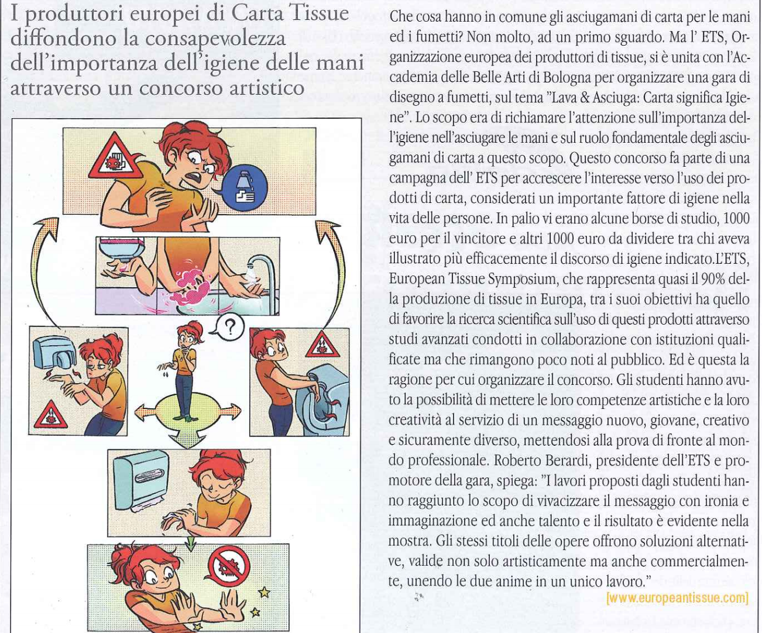
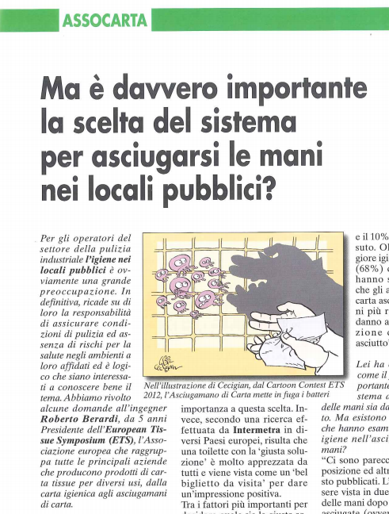
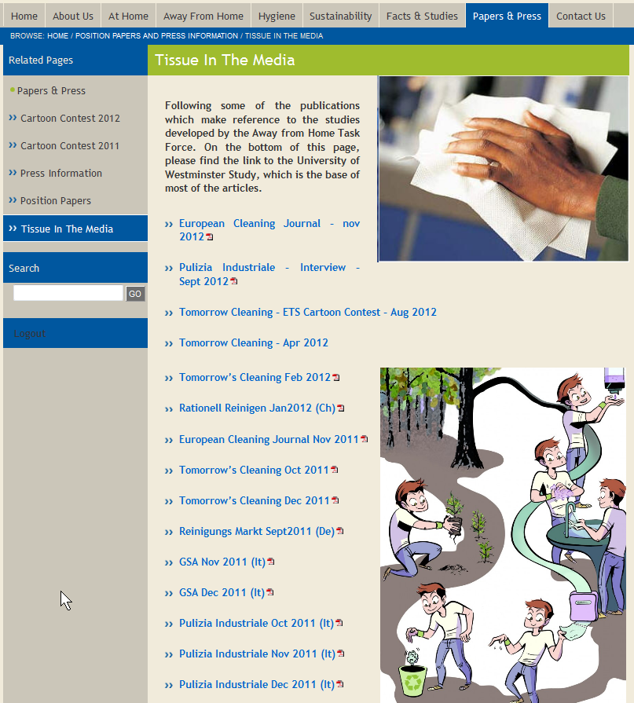
The competition has already received coverage in the past in various media: «Industria della Carta», «Perini Journal», «GSA (Giornale Servizi Ambientali), and also in ECJ (European Cleaning Journal)

Slide 42
Elementi chiave del Concorso 2023 (tutti i dettagli e questa presentazione appariranno presto sul sito web)
The 2023 Competition has 2 sections:
1) Cartoon or Illustration Bologna
Works created by students of the Academy of Fine Arts in Bologna
2) International Cartoon or Illustration Works created by Artists and Students from all over the world
The number of works per author is limited to 1 (one)
The prizes will be:
a scholarship worth € 1,000 for the Comics and Illustration category (Bologna)
a prize of € 1,000 in the Comics and Illustration category (International Contest)
ETS also makes available an additional scholarship/award of € 1,000, to be divided among the works (if any) which, in the unquestionable judgment of ETS, will be particularly interesting from a marketing and communication point of view.
The deadline for the delivery of the works is May 15, 2023.
The authors of the awarded works will be informed via email by 27 May 2023.
A committee designated by the organizers of the competition will select the works. The committee will be composed of ETS members working in Marketing and qualified artists working in the cartoons and illustration sector.
42
42
42
42

Slide 43
Per For more information on the studies and activities of the European Tissue Symposium, please see:
http://www.europeantissue.com/
Per For more information on sustainability and the ETS positions on related issues, see:
https://europeantissue.com/sustainability/
43
43
43
43
43

